Slide 1
Accelerating Direct Marketing Decisions using PySpark: A Case Study on Bank Term Deposits

Slide 2
Problem Statement
In a competitive banking landscape, effectively targeting potential clients for term deposit subscriptions is crucial. The dataset is derived from a Portuguese bank’s direct marketing campaigns. The core business challenge is to predict whether a client will subscribe to a term deposit (‘yes’ or ‘no’), enabling the bank to prioritize outreach to high-potential clients quickly, thereby improving marketing efficiency to compete with competitors and reducing customer acquisition costs by calling predicted customers only.
Business Use:
Help banks improve targeting in marketing campaigns in timely manner

Slide 3
Dataset: Bank Marketing Dataset (UCI Repository)
Records: 45,211 rows, 17 features
Type: Public, real-world, phone-based marketing data
Dataset Overview
Source: UCI Bank Marketing Dataset (45,000+ rows) Features: 16 input columns + y (renamed term_deposit) Key Fields: Job, Marital Status, Education, Month Campaign Contacts, Previous Outcome
 | age | job | marital | education | default | balance | housing | loan | contact | day | month | duration | campaign | pdays | previous | poutcome | y
0 | 58 | management | married | tertiary | no | 2143 | yes | no | unknown | 5 | may | 261 | 1 | -1 | 0 | unknown | no
1 | 44 | technician | single | secondary | no | 29 | yes | no | unknown | 5 | may | 151 | 1 | -1 | 0 | unknown | no
2 | 33 | entrepreneur | married | secondary | no | 2 | yes | yes | unknown | 5 | may | 76 | 1 | -1 | 0 | uknown | no
3 | 47 | blue-collar | married | unknown | no | 1506 | yes | no | unknown | 5 | may | 92 | 1 | -1 | 0 | unknown | no
4 | 33 | unknown | single | unknown | no | 1 | no | no | unknown | 5 | may | 198 | 1 | -1 | 0 | unknown | no
5 | 35 | management | married | tertiary | no | 231 | yes | no | unknown | 5 | may | 139 | 1 | -1 | 0 | unknown | no
6 | 28 | management | single | tertiary | no | 447 | yes | yes | unknown | 5 | may | 217 | 1 | -1 | 0 | unknown | no
7 | 42 | entrepreneur | divorced | tertiary | yes | 2 | yes | no | unknown | 5 | may | 380 | 1 | -1 | 0 | unknown | no
8 | 58 | retired | married | primary | no | 121 | yes | no | unknown | 5 | may | 50 | 1 | -1 | 0 | unknown | no

Slide 4
Main task flow and related techniques
Phase | Tools / Techniques
Data Cleaning | Drop nulls, drop duplicates, etc.
Data exploring and Visualization | Advanced Spark Queries, pyplot
Feature selection | Univariatefestureselector
Data balancing | Random Undersampling
Data engineering | StringIndexer, Encoder, VectorAssembler
Model Training | DT, LR, RF, GBT
Model Evaluation | Accuracy, Precision, Recall, F1
Business trade-off | Business problem analysis and result interpreting in layman language

Slide 5

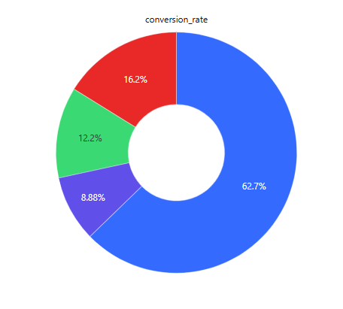
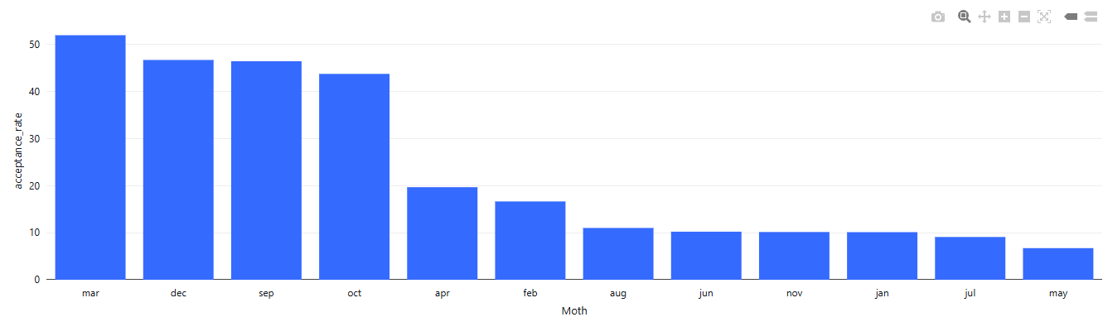
Business Insights and findings
Jobs like student/retiree most likely to say “Yes”
Cellular contact = higher acceptance
Campaigns work best in March, December
Previous success increases current success odds

Slide 6
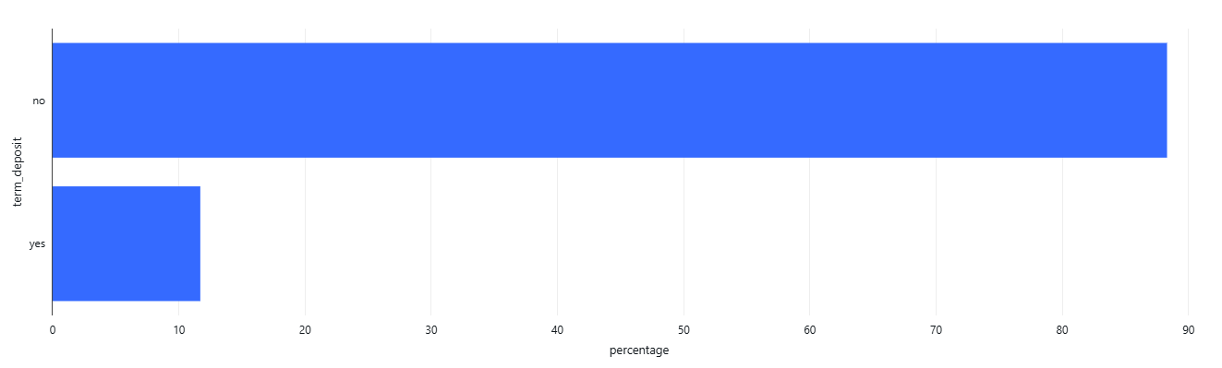
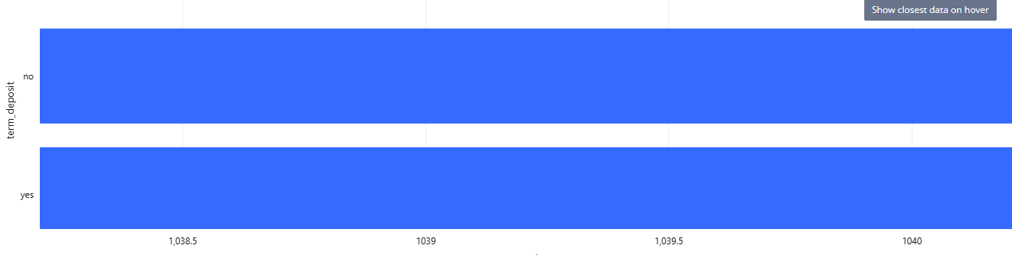
Data Imbalance Check and Balancing Checked imbalance for original data:88% customers say No, 12% say Yes
Before Balancing Data
After Balancing Data

Slide 7
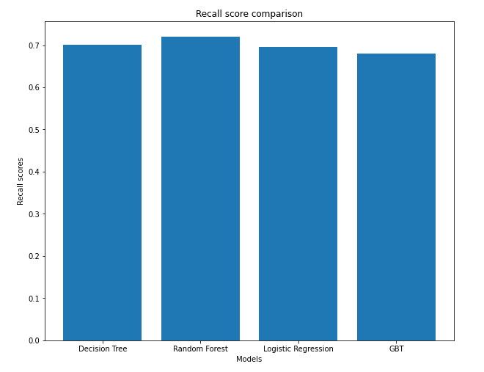
Results: Random Forest Model
Recall = TP / (TP + FN)
TP: Actual clients predicted as subscribers
FN: Actual clients predicted as non-subscribers
Recall: 72.08%
Benefits:
Cost cut
Efficiency

Slide 8
Future Research
Logistic Regression
Random Forest
✅ Precision✅ 73.04%
✅ Recall✅ 72.08%
Gradient Boosted Trees
Decision Tree
✅ F1✅ 72.17%

Slide 9
Thank You For Attention

